Slide 1
Sermon
证道
Dealing with My Sin
對付我們的罪
Pastor Kirt

Slide 2
Joshua約書亞記 7
Dealing with My Sin
對付我們的罪

Slide 3
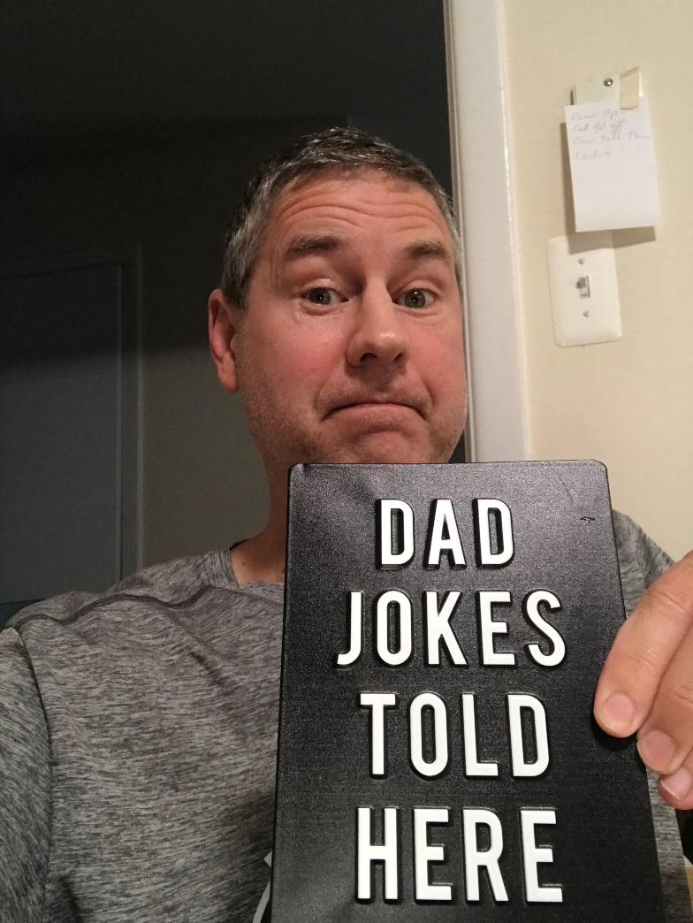

Slide 4
Today’s Goals
For you to understand Truths about sin and the destruction sin causes in your life
Repent of your sin - cut it off
Receive Jesus as your Forgiveness
今天的目標
了解罪的真相，以及罪對我們生命造成的破壞
為罪悔改， 斷絕罪行
接受主耶穌的寬恕

Slide 5
Brief Summary of Joshua 6, 7, 8
Joshua 6 - The Israelites obey God and easily conquer the large city of Jericho - Success.
Joshua 7 - Achan disobeys & sins against God & serves himself so the Israelites cannot conquer the small city of Ai but are actually conquered. Achan’s disobedience and sin causes destruction for himself and his family and his community - Failure.
Joshua 8 - After Achan’s disobedience and sin is stopped & removed – the Israelites easily conquer the small city of Ai - Success.
約書亞記6，7，8章概要
6： 以色列人順服神，輕鬆攻克大城耶利哥 ----- 勝利
7： 亞幹為自己的私慾悖逆得罪神， 以致以色列人無法征服小城艾城， 反被打敗 。 亞幹的不服從和犯罪給他自己、家人和犹太人帶來毀滅 ----- 失敗
當亞幹的悖逆和犯罪被消除後，以色列人輕易征服了艾城 ----- 勝利

Slide 6
What was Achan’s sin? 亞干犯了什麼罪？
Joshua 6:16-19 16 …, Joshua commanded the army, “Shout! For the Lord has given you the city! 17 The city and all that is in it are to be devoted to the Lord. … 18 But keep away from the devoted things, so that you will not bring about your own destruction by taking any of them. Otherwise you will make the camp of Israel liable to destruction and bring trouble on it. 19 All the silver and gold and the articles of bronze and iron are sacred to the Lord and must go into his treasury.”
約 書 亞 記 6:16-19
16到了第七次，祭司吹角的時候，約書亞吩咐百姓說：呼喊罷，因為耶和華已經把城交給你們了！17這城和其中所有的都要在耶和華面前毀滅；只有妓女喇合與他家中所有的可以存活，因為他隱藏了我們所打發的使者。18至於你們，務要謹慎，不可取那當滅的物，恐怕你們取了那當滅的物就連累以色列的全營，使全營受咒詛。19惟有金子、銀子，和銅鐵的器皿都要歸耶和華為聖，必入耶和華的庫中。

Slide 7
Joshua 7:4-5
So about three thousand (Israelites) went up (to Ai); but they were routed by the men of Ai… the men of Ai struck them down on the slopes.
約 書 亞 記 7:4-5
於是民中約有三千人上那裡去，竟在艾城人面前逃跑了。艾城的人擊殺了他們 … 眾民的心就消化如水。

Slide 8
Joshua 7: 6 Then Joshua tore his clothes and fell facedown to the ground before the ark of the Lord, remaining there till evening. The elders of Israel did the same, and sprinkled dust on their heads. 7 And Joshua said, “Alas, Sovereign Lord, why did you ever bring this people across the Jordan to deliver us into the hands of the Amorites to destroy us? If only we had been content to stay on the other side of the Jordan!
約書亞記 7:6
6 約書亞便撕裂衣服；他和以色列的長老把灰撒在頭上，在耶和華的約櫃前俯伏在地，直到晚上。7約書亞說：哀哉！主耶和華阿，你為甚麼竟領這百姓過約但河，將我們交在亞摩利人的手中，使我們滅亡呢？我們不如住在約但河那邊倒好。

Slide 9
8 Pardon your servant, Lord. What can I say, now that Israel has been routed by its enemies? 9 The Canaanites and the other people of the country will hear about this and they will surround us and wipe out our name from the earth. What then will you do for your own great name?”
約書亞記7:8-9
⁸主阿，以色列人既在仇敵面前轉背逃跑，我還有甚麼可說的呢？⁹迦南人和這地一切的居民聽見了就必圍困我們，將我們的名從地上除滅。那時你為你的大名要怎樣行呢？

Slide 10
10 The Lord said to Joshua, “Stand up! What are you doing down on your face? 11 Israel has sinned; they have violated my covenant, which I commanded them to keep. They have taken some of the devoted things; they have stolen, they have lied, they have put them with their own possessions. 12 That is why the Israelites cannot stand against their enemies; they turn their backs and run because they have been made liable to destruction. I will not be with you anymore unless you destroy whatever among you is devoted to destruction.
¹⁰耶和華吩咐約書亞說：起來！你為何這樣俯伏在地呢？¹¹以色列人犯了罪，違背了我所吩咐他們的約，取了當滅的物；又偷竊，又行詭詐，又把那當滅的放在他們的家具裡。¹²因此，以色列人在仇敵面前站立不住。他們在仇敵面前轉背逃跑，是因成了被咒詛的；你們若不把當滅的物從你們中間除掉，我就不再與你們同在了。

Slide 11
[skip 14-15]
16 Early the next morning Joshua had Israel come forward by tribes, and Judah was chosen. 17 The clans of Judah came forward, and the Zerahites were chosen. He had the clan of the Zerahites come forward by families, and Zimri was chosen. 18 Joshua had his family come forward man by man, and Achan son of Karmi, the son of Zimri, the son of Zerah, of the tribe of Judah, was chosen.
略過14-15
¹⁶於是，約書亞清早起來，使以色列人按著支派近前來，取出來的是猶大支派；¹⁷使猶大支派（原文是宗族）近前來，就取了謝拉的宗族；使謝拉的宗族，按著家室人丁，一個一個的近前來，取出來的是撒底；¹⁸使撒底的家室，按著人丁，一個一個的近前來，就取出猶大支派的人謝拉的曾孫，撒底的孫子，迦米的兒子亞干。

Slide 12
19 Then Joshua said to Achan, “My son, give glory to the Lord, the God of Israel, and honor him. Tell me what you have done; do not hide it from me.”
20 Achan replied, “It is true! I have sinned against the Lord, the God of Israel. This is what I have done: 21 When I saw in the plunder a beautiful robe from Babylonia, two hundred shekels of silver and a bar of gold weighing fifty shekels, I coveted them and took them. They are hidden in the ground inside my tent, with the silver underneath.”
¹⁹約書亞對亞干說：我兒，我勸你將榮耀歸給耶和華─以色列的神，在他面前認罪，將你所做的事告訴我，不要向我隱瞞。²⁰亞干回答約書亞說：我實在得罪了耶和華─以色列的神。我所做的事如此如此：²¹我在所奪的財物中看見一件美好的示拿衣服，二百舍客勒銀子，一條金子重五十舍客勒，我就貪愛這些物件，便拿去了。現今藏在我帳棚內的地裡，銀子在衣服底下。

Slide 13
TRUTHS ABOUT MY SIN 關於罪的真相
Joshua 7:20 “I have sinned against the Lord.”
All Sin is against God.
約書亞記 7:20 “我實在得罪了耶和華 ─ 以色列的神。”
所有的罪都是得罪神。

Slide 14
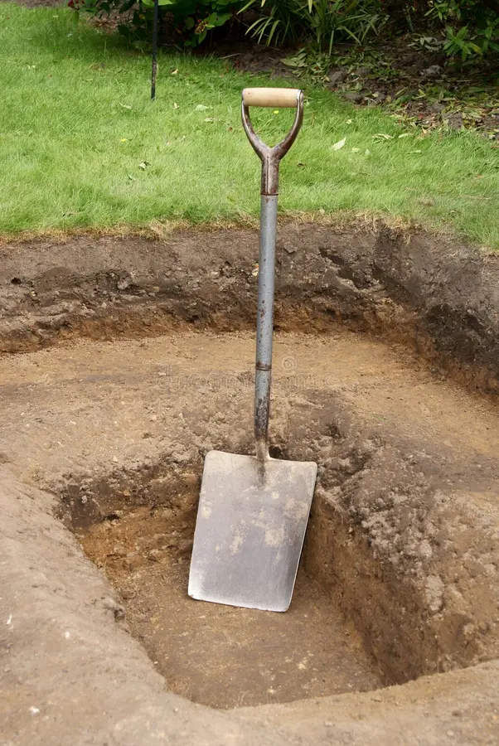
TRUTHS ABOUT MY SIN關於罪的真相
I try to Hide My Sin from God.
4 PLACES I HIDE SIN - HEART, HEAD, HANDS, HOUSE
我想要向神隱藏我的罪
四個隱藏罪的地方──心靈 、頭腦 、 雙手、 家中

Slide 15
Joshua 7:21 “I coveted them and took them” 約書亞記 7:21 “我就貪愛這些物件，便拿去了”
I hide sin in my Heart.
I Hide Sin in My Head
I Hide Sin in My Hands
我把罪隱藏在心裡
我把罪隱藏在頭腦裡
我把罪隱藏在雙手中

Slide 16
I Hide Sin in My House
Joshua 7:21 “They are hidden in the ground inside my tent”
我把罪隱藏在家中
約書亞記 7:21 “現今藏在我帳棚內的地裡”

Slide 17
TRUTHS ABOUT MY SIN關於罪的真相
My sin destroys me
My sin destroys others
我的罪毀了我
我的罪毀了他人

Slide 18
TRUTHS ABOUT MY SIN關於罪的真相
You cannot hide your Sin from God.
你無法向神隱藏你的罪

Slide 19
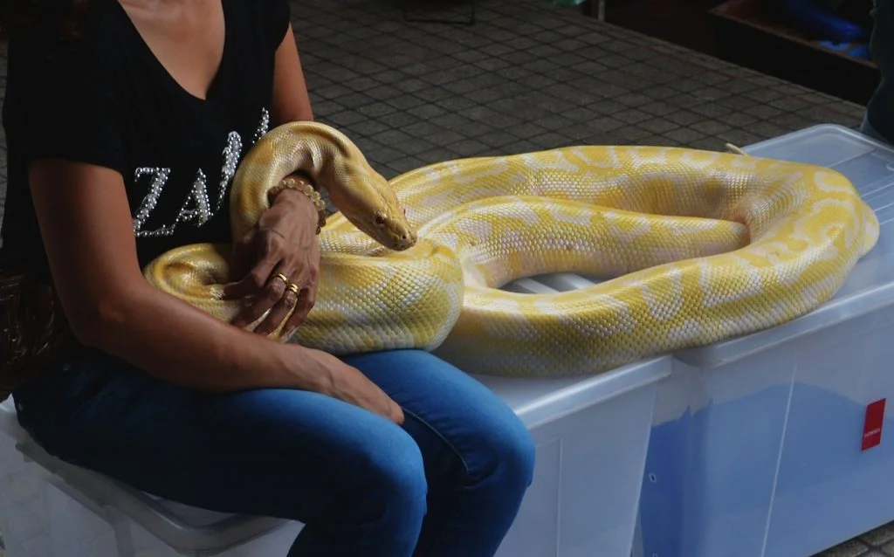
TRUTHS ABOUT MY SIN關於罪的真相
God wants you to Destroy sin before it destroys you.
神希望你在被罪毀滅之前消滅它。

Slide 20
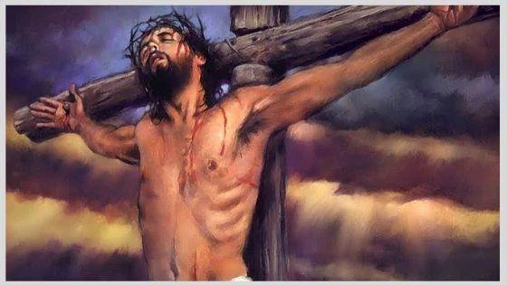
Today God the Doctor deals with sin in a 2 Part Method
1.) Turn from sin - Repent
2.) Turn to Jesus – Receive Jesus
今天神這位大醫生帶領我們做兩件事來對付罪
遠離罪惡－悔改
轉向耶穌－接受耶穌

